Slide 1

Université de Mostaganem — Dr. Madani BELACEL
TIC COURSE 09
Computer Networks
Dr. BELACEL Madani
Année universitaire 2026-2027 / Academic Year 2026-2027
Université de Mostaganem - Département Mathématiques et Informatique

Slide 2
Université de Mostaganem — Dr. Madani BELACEL
Course Outline
▪ 1. What Is a Network?
▪ 2. Network Types
▪ 3. Network Topologies
▪ 4. The OSI and TCP/IP Models
▪ 5. IP Addressing
▪ 6. Tools and Troubleshooting
▪ 7. Network Security

Slide 3
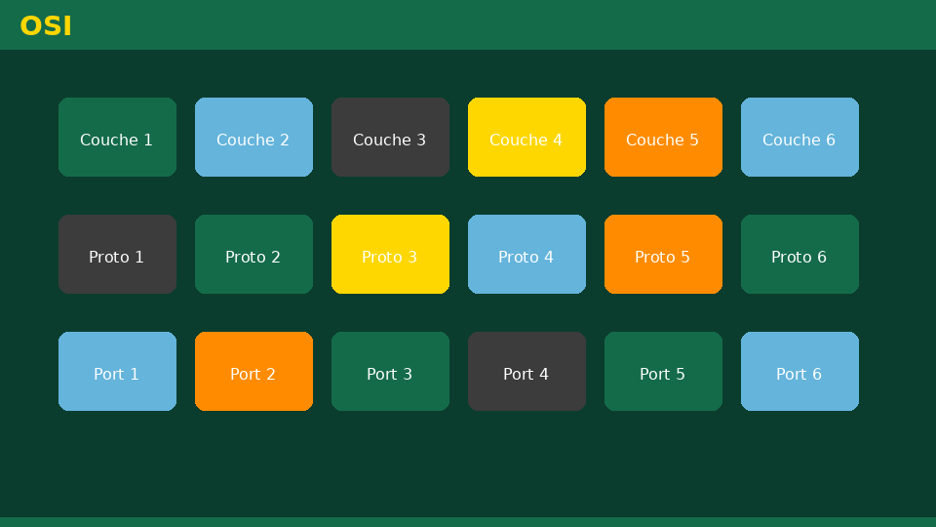
Université de Mostaganem — Dr. Madani BELACEL
Section 1
What Is a Network?

Slide 4
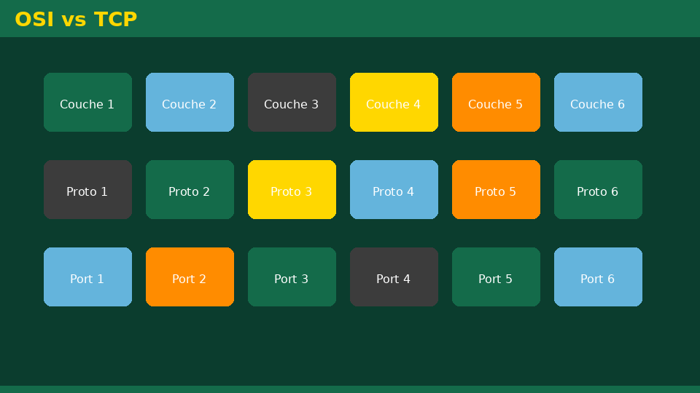
Université de Mostaganem — Dr. Madani BELACEL
1 - What Is a Network?
▪ Interconnected devices exchanging data.
▪ Goals: sharing resources, files, printers, Internet access.
▪ Media: wired (copper, fiber) or wireless links.
▪ Equipment: network cards, switches, routers, access points.

Slide 5

Université de Mostaganem — Dr. Madani BELACEL
Section 2
Network Types

Slide 6

Université de Mostaganem — Dr. Madani BELACEL
2 - Network Types
▪ PAN: personal network (Bluetooth), a few meters.
▪ LAN: local area network (home, lab, company).
▪ MAN: metropolitan area network (city).
▪ WAN: wide area network (the Internet connects millions of LANs).

Slide 7

Université de Mostaganem — Dr. Madani BELACEL
Section 3
Network Topologies

Slide 8

Université de Mostaganem — Dr. Madani BELACEL
3 - Network Topologies
▪ Bus: one shared cable (legacy).
▪ Star: everything goes through a central switch (today's standard).
▪ Ring: loop transmission (Token Ring).
▪ Mesh: maximum redundancy for reliability.

Slide 9
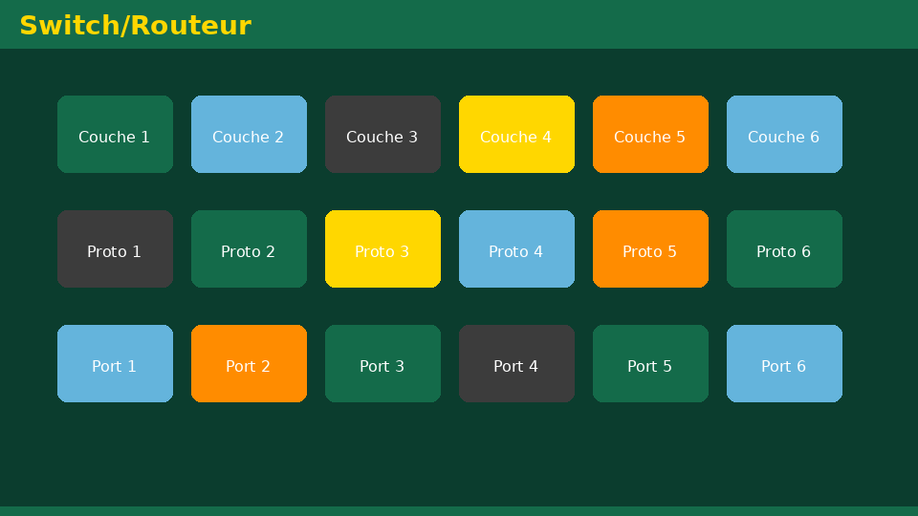
Université de Mostaganem — Dr. Madani BELACEL
Section 4
The OSI and TCP/IP Models

Slide 10

Université de Mostaganem — Dr. Madani BELACEL
4 - The OSI and TCP/IP Models
▪ OSI: 7 layers, from physical cable to application.
▪ TCP/IP: 4 layers, the real Internet model.
▪ Physical, link, network (IP) and transport (TCP/UDP) layers.
▪ Each layer provides a service to the layer above.

Slide 11

Université de Mostaganem — Dr. Madani BELACEL
Section 5
IP Addressing

Slide 12

Université de Mostaganem — Dr. Madani BELACEL
5 - IP Addressing
▪ IPv4: 32-bit address (e.g., 192.168.1.10).
▪ Classes and subnet mask (/24, /16...).
▪ Private vs public addresses; NAT for Internet access.
▪ IPv6: 128 bits, virtually unlimited space.
▪ DHCP: automatic address assignment.

Slide 13

Université de Mostaganem — Dr. Madani BELACEL
Section 6
Tools and Troubleshooting

Slide 14

Université de Mostaganem — Dr. Madani BELACEL
6 - Tools and Troubleshooting
▪ ping: test whether a machine is reachable.
▪ ipconfig / ifconfig: display your IP configuration.
▪ tracert: trace the route to a destination.
▪ nslookup: query the DNS.
▪ Cable tester and equipment LEDs.

Slide 15
Université de Mostaganem — Dr. Madani BELACEL
Section 7
Network Security

Slide 16
Université de Mostaganem — Dr. Madani BELACEL
7 - Network Security
▪ Firewall: filter inbound and outbound traffic.
▪ Secured Wi-Fi: WPA2/WPA3 with a strong password.
▪ VPN: encrypted tunnel for remote access.
▪ Monitoring: logs and intrusion detection.

Slide 17
Université de Mostaganem — Dr. Madani BELACEL
Practical Interest
▪ Install and configure a small LAN (home, lab).
▪ Share printers and files among colleagues.
▪ Troubleshoot a network issue with ping and ipconfig.
▪ Understand the basis for network certifications (CCNA...).

Slide 18
Université de Mostaganem — Dr. Madani BELACEL
Self-Assessment (MCQ)
1. A LAN is:
a) A local area network
b) A worldwide network
c) A cable type
2. How many layers does the OSI model have?
a) 4
b) 5
c) 7
3. Which command tests connectivity to a machine?
a) ping
b) dir
c) copy

Slide 19
Université de Mostaganem — Dr. Madani BELACEL
Conclusion
▪ Networks enable universal resource sharing.
▪ Topology, addressing and protocols are their foundations.
▪ Network security must be planned from the design stage.
▪ Next course: Internet services.

Slide 20
Université de Mostaganem — Dr. Madani BELACEL
References
- A. Tanenbaum, "Computer Networks", Pearson.
- J.-F. Pillou, "TCP/IP Networks", Dunod.
- ICT Course materials, University of Mostaganem.
- www.cisco.com - CCNA resources.

Slide 21
Université de Mostaganem — Dr. Madani BELACEL
Thank you for your attention!
Questions?
Dr. BELACEL Madani

